Slide 1
Midterm Project
By: Paula Buitrago

Slide 2
Do students with higher GPA report having more mental health issues like depression and anxiety?

Slide 3
Importance:
Dataset used:
College plays a major role in mental health, and as students, we can relate to the stress and pressure that comes with it.
There’s often an assumption that students with high GPAs are doing great, but in reality, they might be under a lot of pressure, leading to anxiety and depression.
Exploring this connection can raise awareness and encourage a healthier balance between academics and mental well-being.
I used the Student Mental Health dataset by Shariful Islam.
The data was collected through a survey conducted at the University of Malaysia.
Consists of 101 objects and 11 variables.
https://www.kaggle.com/datasets/shariful07/student-mental-health

Slide 4
Data Analysis Process:
Read the CSV file, checked its dimensions, structure, missing values, and created summary statistics.
Renamed the columns used to answer my research question for clarity (depression, anxiety, GPA).
Converted GPA from a character to a categorical variable.
Created frequency tables to analyze the relationship between GPA and the two mental health conditions I chose (depression and anxiety).
Used bar plots to display the distribution of depression and anxiety across different GPA categories.
Customized the graphs with colors, titles, and legends for better visualization.

Slide 5
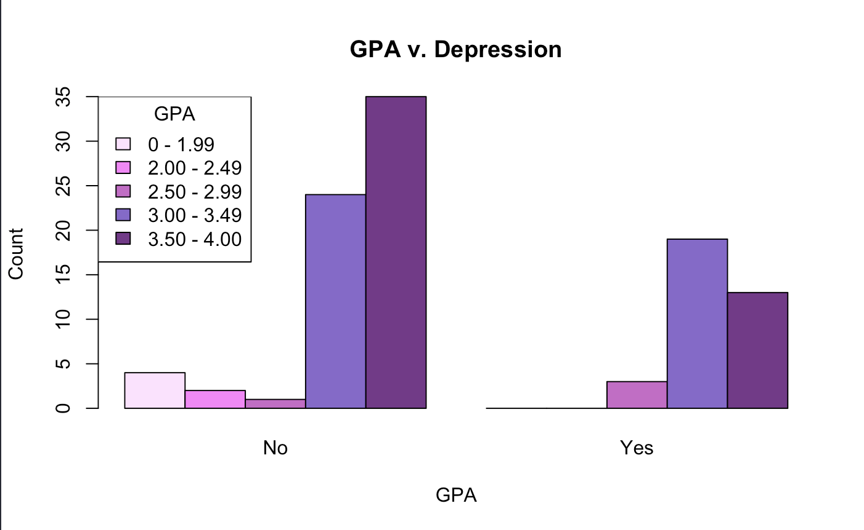
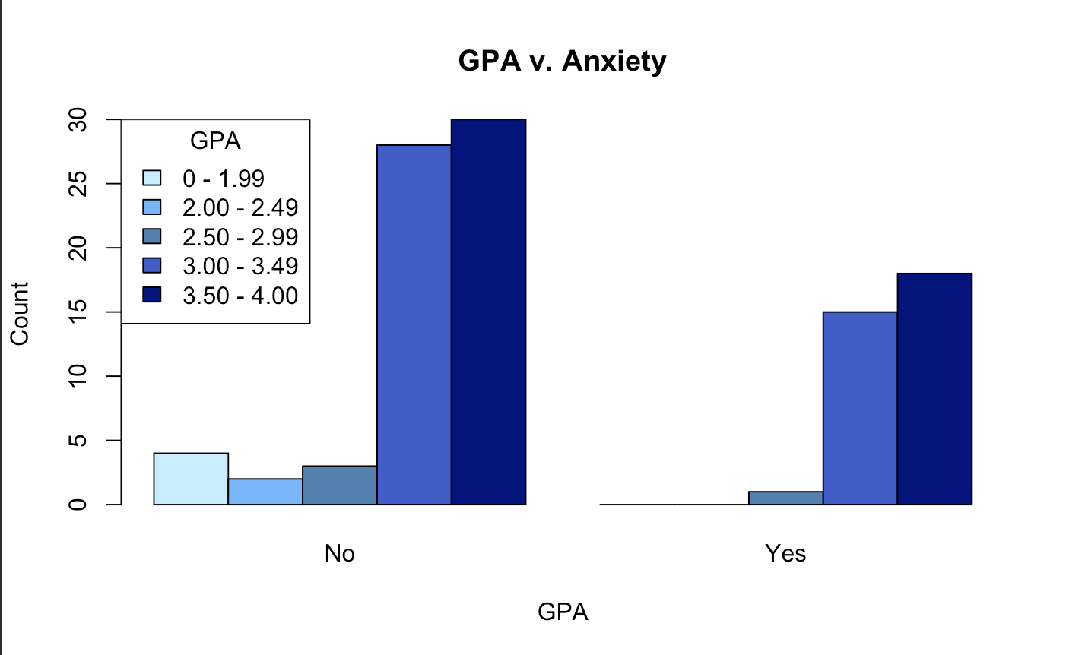
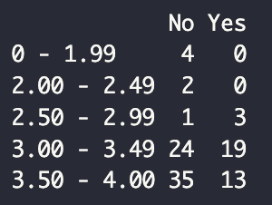
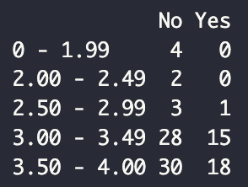
This data answers my question by showing that students who do better in school experience more depression and anxiety compared to lower GPA students. With that said, those with the highest GPA tend to experience more anxiety than depression.
Notes:
The graph to the left shows that students with B average grades (3.00 – 3.49) reported having depression more than the other groups of students. The graph to the right shows that students with A average grades (3.50 – 4.00) reported having anxiety more than the other groups of students.

Slide 6
Obstacles:
Learning how to insert a legend into the graphs.
Selecting a dataset that had substantial information to answer my research question.
Debugging syntax errors in the data analysis process.
Consider more variables like students’ majors, age, and gender.
Compare the data with students from different universities and community colleges.
Collect data from a larger and more diverse population to get clearer trends.
Future steps:

